Slide 1

The Battle of Neighborhoods Chennai
Applied Data Science Capstone
by IBM on Coursera
Mouni Mallela

Slide 2
INTRODUCTION: BUSINESS PROBLEM
This project deals with the major venue categories in the neighborhoods of Chennai, The Detroit of India This project would specifically help Business personal plan to start new Restaurants, Hotels, etc in Chennai, Tamil Nadu, India.
The major Target Audience would be small scale business owners and stake holders planning to start their business at a location in Chennai This project would help them find the optimal location based on the category of their business such as:
What is the best location to start a new hotel in Chennai with restaurants around?
Which area is best suitable for opening a Shopping Mall in Chennai?

Slide 3
INTRODUCTION: BUSINESS PROBLEM
The Foursquare API is used to access the venues in the neighborhoods Since, it returns less venues in the neighborhoods, we would be analyzing areas for which countable number of venues are obtained
Then they are clustered based on their venues using Data Science Techniques Here the k means clustering algorithm is used to achieve the task The optimal number of clusters can be obtained using silhouette score metrics.
Folium visualization library can be used to visualize the clusters superimposed on the map of Chennai city These clusters can be analyzed to help small scale business owners select a suitable location for their need such as Hotels, Shopping Malls, Restaurants or even specifically Indian restaurants or Coffee shops

Slide 4
DATA REQUIREMENTS
Chennai has multiple neighborhoods The chennaiiq.com website has a dataset which has the list of locations in Chennai along with their Latitude and Longitude In order to obtain the venue details in each neighborhood Foursquare API is used.
https://chennaiiq.com/chennai/latitude_longitude_areas.asp
https://foursquare.com/
There is a total of 105 neighborhoods But the Latitude and Longitude data obtained are in Degrees Minute Seconds format which needs to be converted to Decimal Degrees Format T h e details obtained from Foursquare API are Venue, Venue Latitude, Venue Longitude and Venue Category A total of 1022 venues data have been obtained from Foursquare.

Slide 5
METHODOLOGY
Now, we have the neighborhoods data of Chennai 105 neighborhoods We also have the most popular venues in each neighborhood obtained using Foursquare API A total of 1022 venues have been obtained in the whole city and 145 unique categories But as seen we have multiple neighborhoods with less than 10 venues returned In order to create a good analysis let's consider only the neighborhoods with more than 10 venues.
We can perform one hot encoding on the obtained data set and use it find the 10 most common venue category in each neighborhood Then clustering can be performed on the dataset Here K Nearest Neighbor clustering technique have been used To find the optimal number of clusters silhouette score metric technique is used.
The clusters obtained can be analyzed to find the major type of venue categories in each cluster This data can be used to suggest business people, suitable locations based on the category.

Slide 6
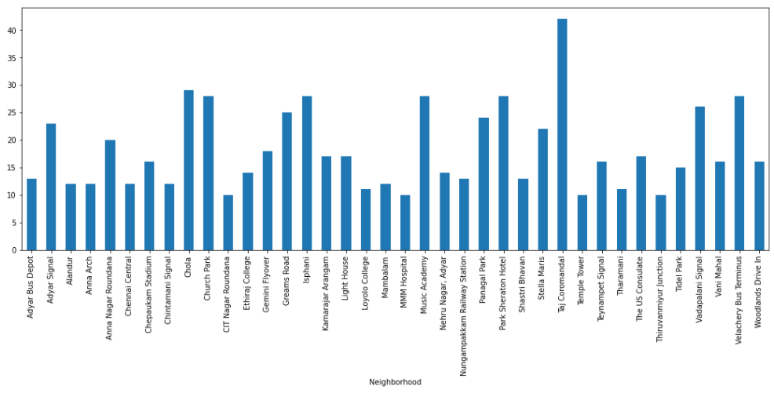
ANALYSIS
Looking into the dataset we found that there were many neighborhoods with less than 10 venues which can be remove before performing the analysis to obtain better results The following plot shows only the neighborhoods from which 10 or more than 10 venues were obtained The resultant dataset consists of 37 neighborhoods.

Slide 7
ANALYSIS
O ne hot encoding is performed on the filtered data to obtain the venue categories in each neighborhood Then group the data by neighborhood and take the mean value of the frequency of occurrence of each category.
This is used to obtain the top 10 most common venues in each neighborhood i e the 10 venues with the highest mean of frequency of occurrence.
The resultant dataset can be used for the clustering algorithm Here, the K Nearest Neighbor ( clustering algorithm is used It is an unsupervised machine learning technique that clusters the given data into K number of clusters.
For optimal result we need to select the best value for K Here, the silhouette score is used to find the best value for K

Slide 8
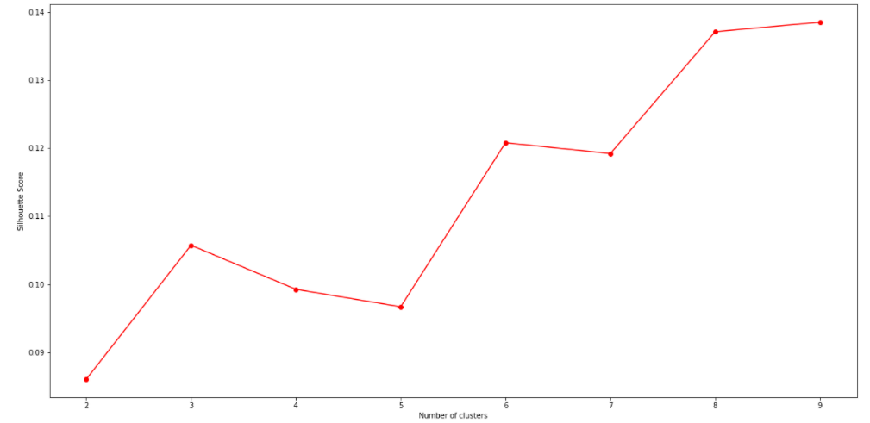
ANALYSIS
A range of values from 2 to 10 was considered, KNN clustering was performed on the dataset and the silhouette score was calculated and plotted on a line plot From the plot we can see that a K value of 8 provides the best score This K value is used for the K Means Clustering Technique The K Means labels obtained were included in the top neighborhoods dataset for examining the characteristics of each cluster.

Slide 9
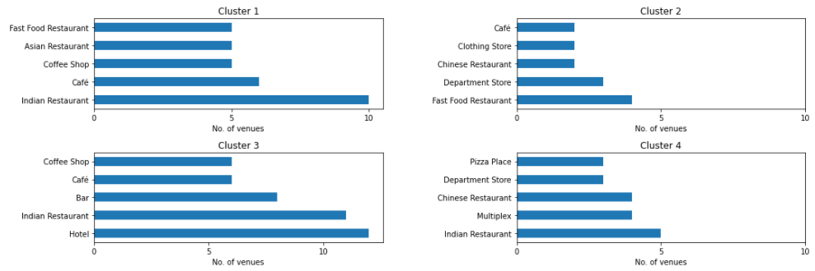
RESULTS AND DISCUSSION
Using the clusters and the top venue categories let’s visualize the top 5 venue category in each Cluster for comparison.
Clusters 1 to 4

Slide 10
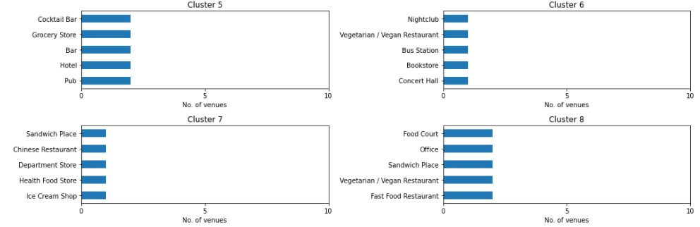
RESULTS AND DISCUSSION
Using the clusters and the top venue categories let’s visualize the top 5 venue category in each Cluster for comparison.
Clusters 5 to 8:

Slide 11
RESULTS AND DISCUSSION
Hotel
The neighborhoods in cluster 2 has the greatest number of hotels, hence opening one here is not the best choice So, is it best to open one at the neighborhoods in cluster 7 or 8 Not likely, since the place has a smaller number of food restaurants Thus, an optimal place would be one which has less hotels, but also have restaurants and other places to explore Considering all these facts, the best choice would be Cluster 3 and Cluster 4.
Shopping Mall
The neighborhoods 5 has notable number of shopping malls By using the same procedure as above, the suitable cluster would be the Cluster 2 and Cluster 3 since it has not much shopping malls and also it has many Hotels and Restaurants which gives an advantage.

Slide 12
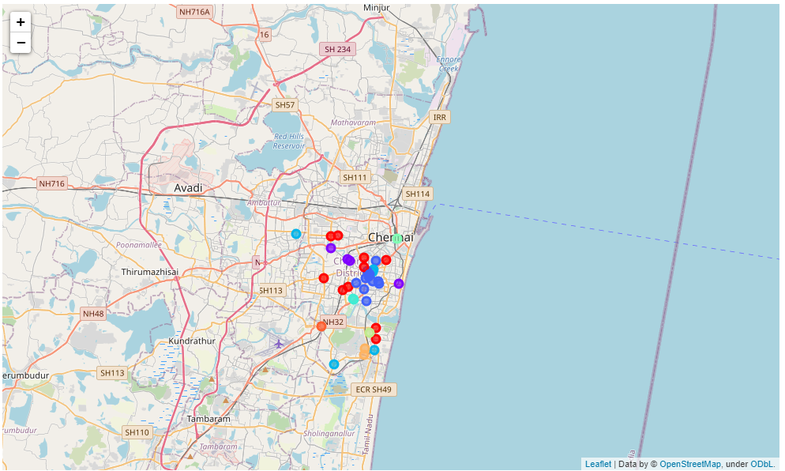
RESULTS AND DISCUSSION
The following is a map of Chennai with the neighborhood clusters superimposed on top of it This map can be used to suggest a vast location to start a new business based on the category.

Slide 13
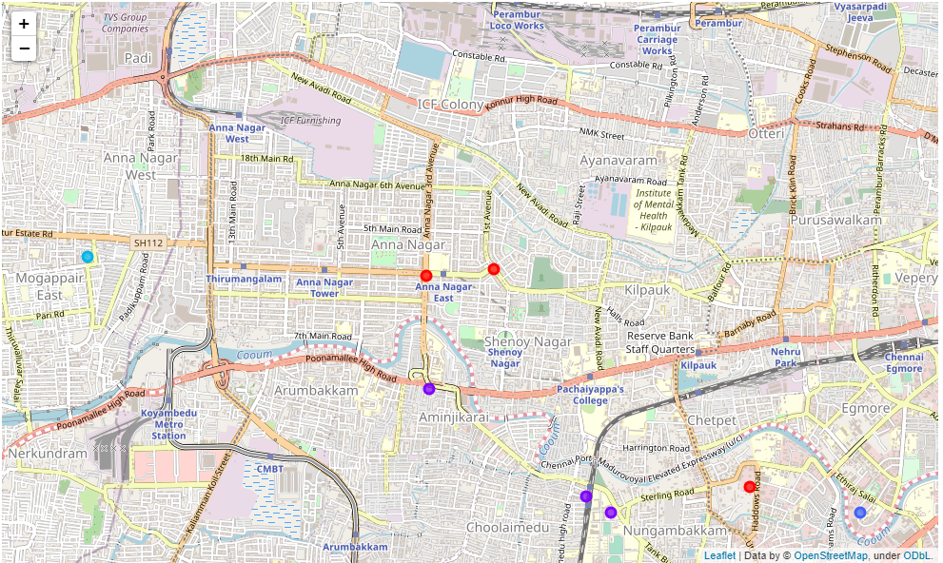
RESULTS AND DISCUSSION
For example, the highlighted location shown in the below figure consists of Cluster 3 and Cluster 5 whose neighborhoods have many Restaurants and Shopping Malls but less Hotels Thus, this would be a suitable location for building a hotel.

Slide 14
DRAWBACKS
A major limitation of this project was that the Foursquare API returned only few venues in each neighborhood.
As a future improvement, better data sources can be used to obtain more venues in each neighborhood.
This way the neighborhoods that were filtered out can be included in the clustering analysis to create a better decision model using KNN clustering algorithm.

Slide 15
CONCLUSION
Purpose of this project was to analyze the neighborhoods of Chennai and create a clustering model to suggest places to start a new business based on the category.
The neighborhoods data was obtained from an online source and the Foursquare API was used to find the major venues in each neighborhood.
The best number of clusters i e 8 was obtained using the silhouette score Each cluster was examined to find the most venue categories present, that defines the characteristics for that particular cluster.
A few examples for the applications that the clusters can be used for have also been discussed A map showing the clusters have been provided Both these can be used by stakeholders to decide the location for the particular type of business.

